Slide 1
COURIER COMPANY DATABASE
201426010 - Melis ÇIKIŞ
201411034 - Ali Cem KOÇ
201411042 - Bilge NAS

Slide 2
Topics
Courier Company Database
E-R Design
Entities
Relationships
Converting E-R Model to Relational Model
Tables
Queries
Summary

Slide 3
Courier Company Database (1)
The database for courier companies.
This database includes information about people and companies who product sender and receiver. Like that name, surname, city, telephone, email.
If sender or receiver is a company, the company may have many sales. It is checked with a unique code.

Slide 4
Courier Company Database (2)
The database should contain information about a product which is sent or received.
The product is separated according to its cost.
Each product has when is delivered and by whom.
Tha database has a date which is delivering cargo, courier, and customer.

Slide 5
E-R Model (1)
1. Entities
Customer Type
Retail Customer
Corporate Customer
Product
C-P-Index
Cargo Type
Cost
Sales
Personnel

Slide 6
E-R Model (2)
Cont. Entities
Personnel Type
Date
2. Relationships
Each retail customer and corporate customer have customer type.
Each corporate customer includes sales about own company.
All products have cost and cargo type.

Slide 7
Customer Type Entity and its Attributes
A customer type is identified by Customer Type Id. The attributes are
CustomerTypeId
CustomerTypeName

Slide 8
Retail Customer Entity and its Attributes
For each RetailCustomer, an ID is used. The attributes are
RetailId
RetailName
RetailSurname
RetailCity
RetailCounty
RetailAddress
RetailTel1
RetailTel2
RetailEmail1
RetailEmail2
refCustomerTypeId (Foreign Key)

Slide 9
Corporate Customer Entity and its Attributes
All corporate customers have an ID as a primary key. The attributes are
CorporateId
CorporateCode
CorporateName
CorporateCity
CorporateCounty
CorporateAddress
CorporateTel1
CorporateTel2
CorporateEmail1
CorporateEmail2
refCustomerTypeId (Foreign Key)

Slide 10
Cost Entity and its Attributes
A cost is identified with Cost ID. The attributes are
CostId
CostTypeName
Unit
Cost

Slide 11
Cargo Type Entity and its Attributes
For each CargoType an ID is used. The attributes are
CargoTypeId
Type

Slide 12
Product Entity and its Attributes
All products have an ID as a primary key. The attributes are
ProductId
refCostId (Foreign Key)
Sensibility
Number
ProductCost
refCargoTypeId (Foreign Key)
CargoCost

Slide 13
Sales Entity and its Attributes
A sales are identified by Customer Type Id. The attributes are
SalesId
Price

Slide 14
Contractual Company Entity and its Attributes
This table is like a bridge between Corporate Customer and Sales tables. It’s attributed are
ContractualId
refCompanyName
refCompanyCode
refSaleId (Foreign Key)

Slide 15
C-P-Index Entity and its Attributes
For each CPIndex an ID is used. The attributes are
CPId
refRetailId (Foreign Key)
refCorporateId (Foreign Key)
refProductId (Foreign Key)

Slide 16
Personnel Type Entity and its Attributes
All personnel type has an ID as a primary key. The attributes are
PersonnelTypeId
PersonalName

Slide 17
Personnel Entity and its Attributes
A cost is identified with Cost ID. The attributes are
PersonnelId
refPersonnelTypeId
PersonnelName
PersonnelSurname
PersonnelTel1

Slide 18
Date Entity and its Attributes
A customer type is identified by Customer Type Id. The attributes are
DateId
DeliverDateName

Slide 19
Cargo History Entity and its Attributes
This table is like a bridge between Date, C-P-Index and Personnel tables. It’s attributed are
Status
refIndexId (Foreign Key)
refDateId (Foreign Key)
refPersonnelId (Foreign Key)
DeliverDateN

Slide 20
Relationships (1)
One person or company has a unique type.
A customer type may be in different customers.
The relationship between CustomerType, RetailCustomer, and CorporateCustomer is a one to many relationships. This relationship is defined as a foreign key.

Slide 21
Relationships (2)
Contractual Company:
A company may have different sales.
A sale may be the same at the different companies.
Contractual Company is a many to many relationships.

Slide 22
Relationships (3)
A product has a unique cost.
A cost may be in many products.
The relation between Product and Cost tables is one to many relations. This relationship is defined as a foreign key.

Slide 23
Relationships (4)
A product includes one cargo type.
One cargo type can be in different products.
The relation between Product and CargoType tables is one to many relations. This relationship is defined as a foreign key.

Slide 24
Relationships (5)
One personnel has a unique type.
A personnel type may be in different personnel.
The relationship between PersonnelType and Personnel is a one to many relationships. This relationship is defined as a foreign key.

Slide 25
Relationships (6)
A retail customer, corporate customer or product may have different indexes.
An index is unique for each customer of the product.
The relationship between C-P-Index and RetailCustomer, CorporateCustomer, Product is a one to many relationships for each one. This relationship is defined as a foreign key.

Slide 26
Relationships (7)
Cargo History:
More than one product can be delivered by different personnel at a date.
A personnel can deliver different products on a date.
Cargo History is a many to many relationships.
At the same time, it is a Ternary Relationship between the C-P-Index, Date and Personnel tables.

Slide 27
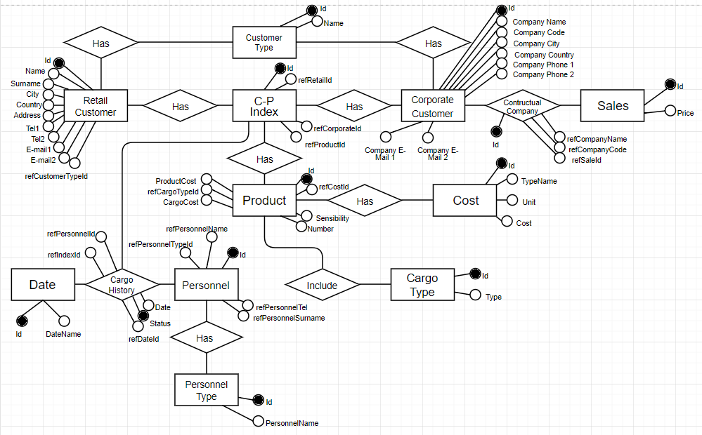
E-R Model

Slide 28
Relational Model for the Courier Company Database
Some of the tables are created:
CustomerType (CustomerTypeId is a primary key)
RetailCustomer (RetailId is a primary key, refCustomerTypeId is foreign key)
CorporateCustomer (CorporateId is primary key, refCustomerTypeId is foreign key)
Sales ( SalesId is a primary key)

Slide 29
Converting Relationships (1)
Contractual Company is converted to a table as
ContractualCompany < ContractualId, refSalesId, refCompanyName, refCompanyCode >
ContractualId is primary key
refSalesId is foreign key

Slide 30
Converting Relationships (2)
Cargo History is converted to a table as
CargoHistory < Status, refIndexId, refDateId, refPersonnelId, DeliverDateN >
Status is primary key
refIndexId, refDateId, refPersonnelId is foreign key

Slide 31
Some Queries
The following queries are given as example:
Create table for Contractual Company entity
Insert Retail Customers
Select the total cargo costs of products which are going from Ankara to Istanbul

Slide 32
CREATE CONTRACTUALCOMPANY TABLE
CREATE TABLE ContractualCompany
(
ContractualId int IDENTITY(1,1) PRIMARY KEY,
refCompanyName nvarchar(30) NOT NULL,
refCompanyCode int NOT NULL,
refSaleId int NOT NULL,
FOREIGN KEY (refSaleId) REFERENCES Sales(SalesId)
);

Slide 33
INSERT RETAIL CUSTOMERS (1)
INSERT INTO RetailCustomer (RetailName, RetailSurname,
RetailCity, RetailCounty,
RetailAddress, RetailTel1,
RetailEmail1, refCustomerTypeId)
VALUES ('Melis','Cikis','Ankara','Cankaya','Hosdere Caddesi',
'85208520','mls@gmail.com','1')

Slide 34
INSERT RETAIL CUSTOMERS (2)
INSERT INTO RetailCustomer (RetailName, RetailSurname,
RetailCity, RetailCounty,
RetailAddress, RetailTel1,
RetailEmail1, refCustomerTypeId)
VALUES ('Ali Cem','Koc','Istanbul','Sariyer','Buyukdere Caddesi',
'1325896','ack@gmail.com','1')

Slide 35
SELECT THE TOTAL CARGO COSTS OF PRODUCTS WHICH ARE GOING FROM ANKARA TO ISTANBUL
SELECT SUM(Product.CargoCost) as TotalCargoCost
FROM Product, CPIndex
WHERE Product.ProductId = (SELECT CPIndex.refProductId
FROM RetailCustomer, CorporateCustomer, CPIndex
WHERE RetailCustomer.RetailCity = 'Ankara' AND
CorporateCustomer.CorporateCity = 'Istanbul')

